Slide 1
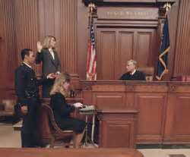
Oaths and Affirmations
March 2013
Notes:
Good morning everyone, I’m __________ and I want to welcome you to this special NNA Webinar event: Using Credible Witnesses.
[The National Notary Association has been around for more than 50 years. We are an association that strives to offer exceptional educational programs to Notaries all over the U.S. As part of our core values, the NNA believes that compliance with your state’s laws, managing liability risks, and being a professional, provides the best protection for you, the notary, as well as your signer. We are here to serve you.]
Today’s informational webinar on how to use credible witnesses is our way of thanking you for serving your public and providing you with the support you need.
The information presented today is not state specific. It is important that you review your state’s Notary Public laws to ensure these practices are applicable. However we will provide you with a strong foundation on which you can build your notary best practices.
So let’s get started.

Slide 2
Introduction
What is an oath or affirmation?
A spoken promise or declaration of truthfulness
A pledge of loyalty
A part of another notarial act
A notarial act on its own

Slide 3
Oaths and Affirmations
Oath of Public Office
Oath for a Witness
Oath of Citizenship

Slide 4
Important Terms
Oath: Solemn, spoken pledge to a Supreme Being
Affirmation: Solemn spoken pledge on one’s own honor
Affiant: Signer of an affidavit (document to be sworn to)
Affirmant: One who makes an affirmation
Deponent: A person, who under oath or affirmation, gives testimony for legal proceedings
Affirm/Depose/Swear: To declare under penalty of perjury

Slide 5
Notary’s Responsibility
Require personal appearance
Administer an oath or affirmation
Spoken Oaths
Written Oaths

Slide 6
Sample of Spoken Oaths
“Do you swear to tell the truth, the whole truth and nothing but the truth?” [So help you God]”?
“I, ______ do solemnly swear (or affirm) that I will faithfully, impartially and justly perform all the duties of the office of _____ to the best of my ability.”
[“So help me God.”]

Slide 7
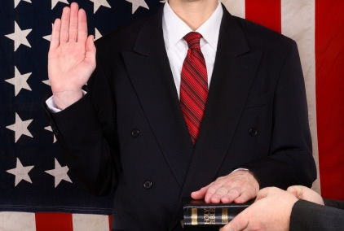
Ceremony of Oaths and Affirmations
Raising of the right hand
Standing
Verbal response

Slide 8
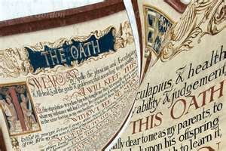
Written Oaths and Affirmations

Slide 9
Sample of a Written Oath
State of Illinois County of ________________
On this the _______ day of ______________________, _______, I, (name of affiant) ___________________________________ do solemnly swear that the statements contained in this affidavit are true to the best of my knowledge and belief.
_____________________________________________________Affiant Signature
Witness my hand and seal, ________________, Notary Public of the State of Illinois, Commission Expires: ________________________
Signed___________________________________ Seal:
Date_________________________
Signer’s Statement

Slide 10
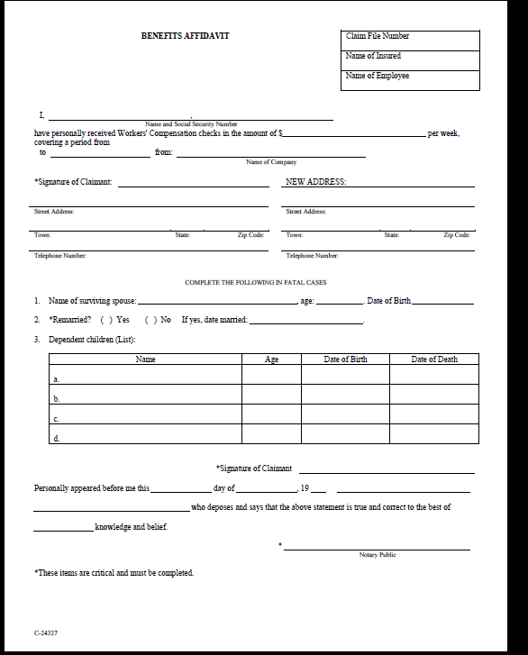
Samples of Certificate Wording
Personally appeared before me this _____ day of ___________, 20___ ___________________
who deposes and says that the above statement is true and correct to the best of
___________________ knowledge and belief.
___________________ Notary Public
Certificate

Slide 11
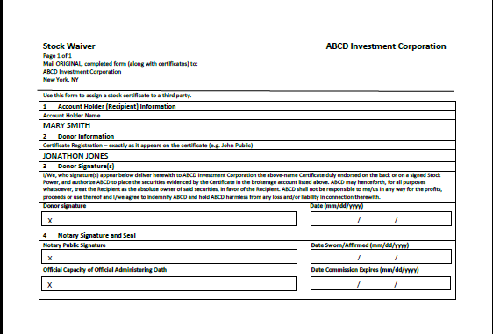
Samples of Certificate Wording
4. Notary Signature and Seal
Notary Public Signature Date Sworn/Affirmed (mm/dd/yyyy)
Certificate
X
/ /
Official Capacity of Official Administering Oath Date Commission Expires (mm/dd/yyyy)
X
/ /

Slide 12
Samples of Certificate Wording
State of:
County of:
On this _____ day of _________, 2013, before me personally appeared, to me known, who being duly sworn, did depose and say: that (he/she) resided in _______________, that (he/she)is the ___________________ of the corporation described in this instrument as the Insured and on behalf of which (he/she) has executed this instrument, that he/she) know the seal of said corporation; that the seal affixed to this instrument is the said corporate seal; that it was so affixed by the order of the Board of Directors of said corporation and that (he/she) signed (his/her) name thereto by like order.
____________________
NOTARY PUBLIC

Slide 13
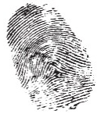
The Journal Record
1
2
3
4
5
Date and time of notarization
Oath
Location of notarization
Spoken oath
Printed name, address, city of affirmant
6
7
8
9
10
Additional information
Identification method and information
$
Affirmant’s signature

Slide 14
Summary
An oath or affirmation is a notarial act on its own:
Affirmant must personally appear
The Notary administers an oath
Look for the key words or phrases in the certificate
Complete the journal record
Notes:
Using credible witnesses is a method of identification that has been in practice for centuries. So let’s take a step back into history. Many states had to enact codes to regulate how Notaries identify a signer because there were no cars, no driver’s licenses, and no standardized identification documents.
Also, people didn’t get around as much; they generally stayed within their local communities where people knew one another.
The only way a Notary could identify a signer was by personally knowing the signer, or by using a credible identifying witness - a person known to the notary – that could vouch for the identity of that signer. We will demonstrate this in just a few moments.

Slide 15
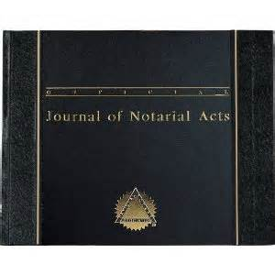
Resources to Assist You
State-specific Law Primers
Notary journals
Additional training

Slide 16
Q & A
For further information, contact:
hotline@nationalnotary.org
1-888-876-0827
Hotline Counselors are available to assist you:
Monday-Friday 5:00 a.m.-7:00 p.m., PT
Saturday 5:00 a.m.-5:00 p.m., PT
Webinar Archives at:
http://www.nationalnotary.org/webinar-archives/index.html
Notes:
I’m going to introduce Luis Villaneda, he will answer your questions, and provide you with the email address and phone number for further information.

Slide 18
Connect with the NNA and other Notaries
through our social media channels!
Stay updated on the latest NNA events, news and best practices.
facebook.com/nationalnotary
twitter.com/nationalnotary
http://www.linkedin.com/in/nationalnotary
Notes:
Connect with other NNA members, stay informed on special events, and learn about recent notary laws and notary best practices.

Slide 19
Connect with the NNA and other Notaries
through our social media channels!
Tell us what topics would you like to see discussed in this webinar forum
Share a challenging or unusual experience you have encountered as a Notary Public
Share your Notary success stories

Slide 20
Thank you for joining us!
The National Notary Association
www.nationalnotary.org
Notes:
I’m going to introduce Luis Villaneda, he will answer your questions, and provide you with the email address and phone number for further information.

